Slide 1
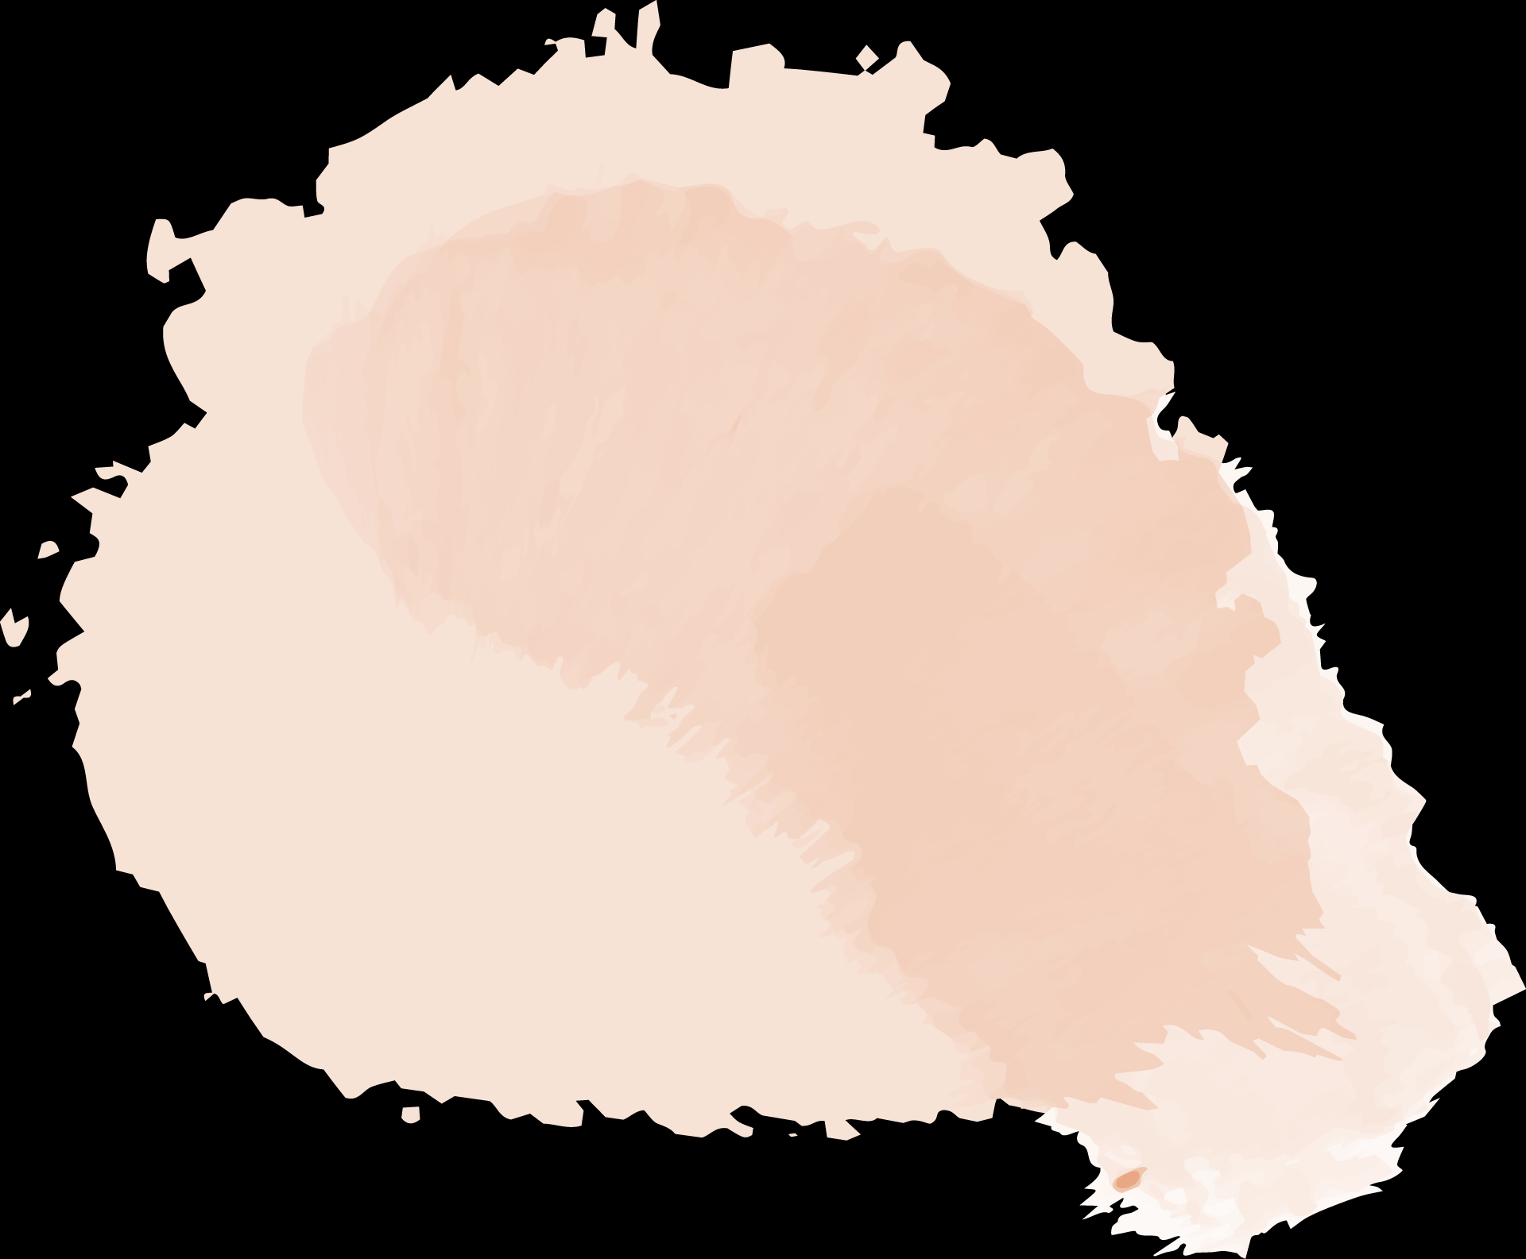


Imitation of Go Skill Levels
and Recognition of Go Playing Styles
112753207張詠軒

Slide 2

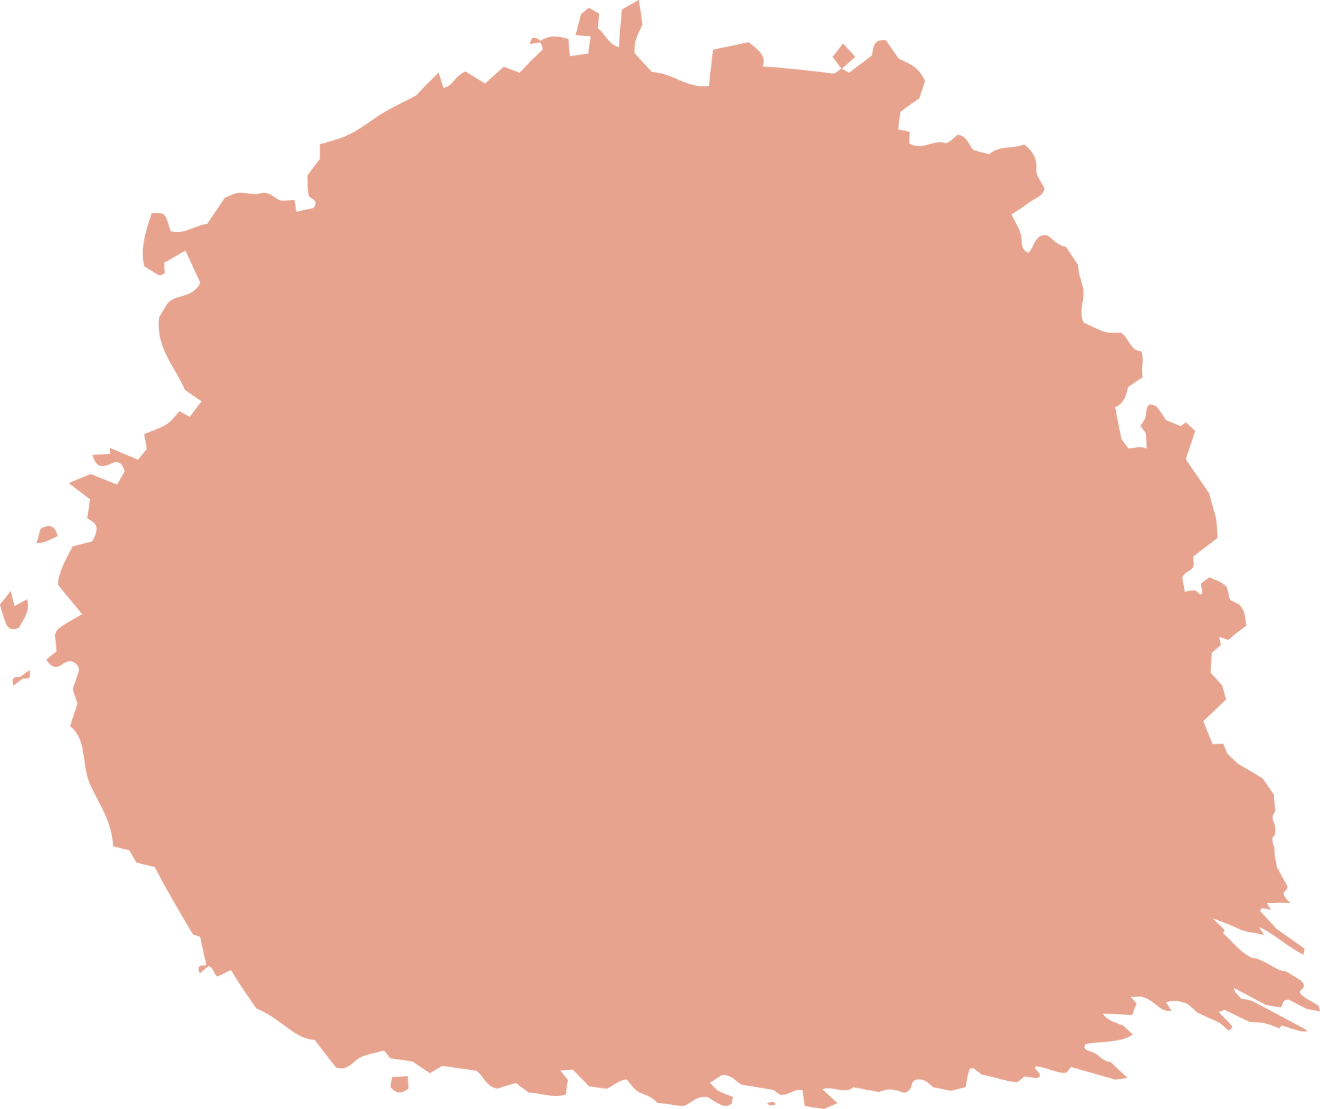
Outline
Introduction
01
02
Method
03
Experiment &
Conclusion
What we do
How we do

Slide 3
01
Introduction

Slide 4
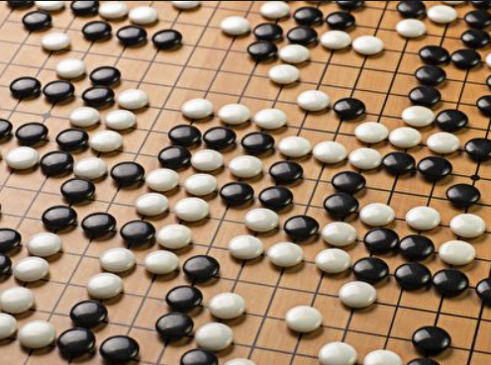
Introduction
Go is a strategic board game played on a gridded board using black and white stones for gameplay.
mimic and recognize human behavior through Go game records
goal : conduct training and predictions

Slide 5
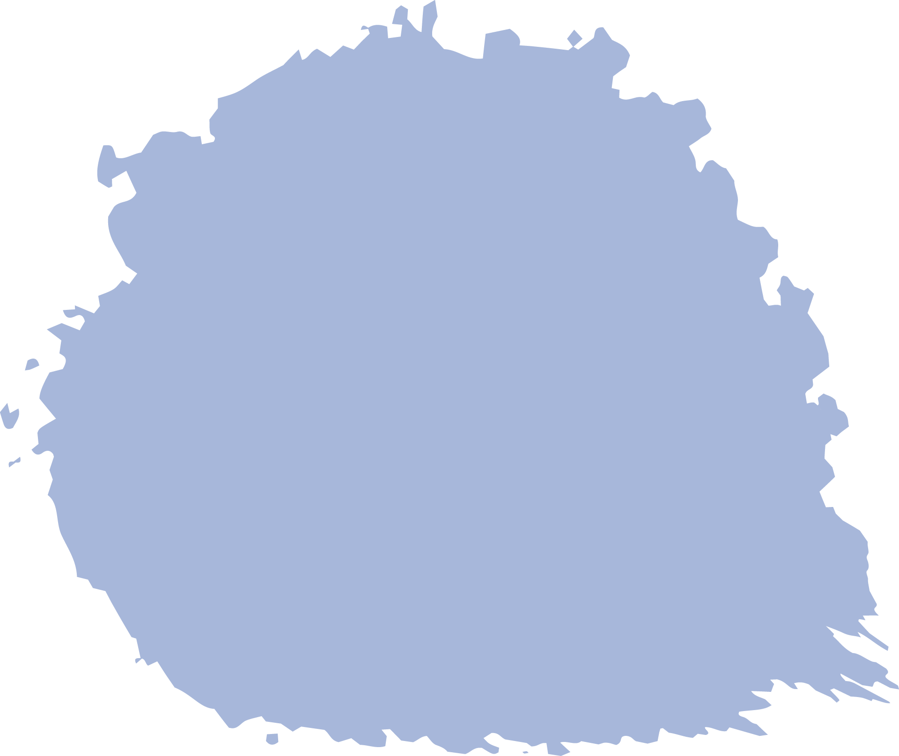
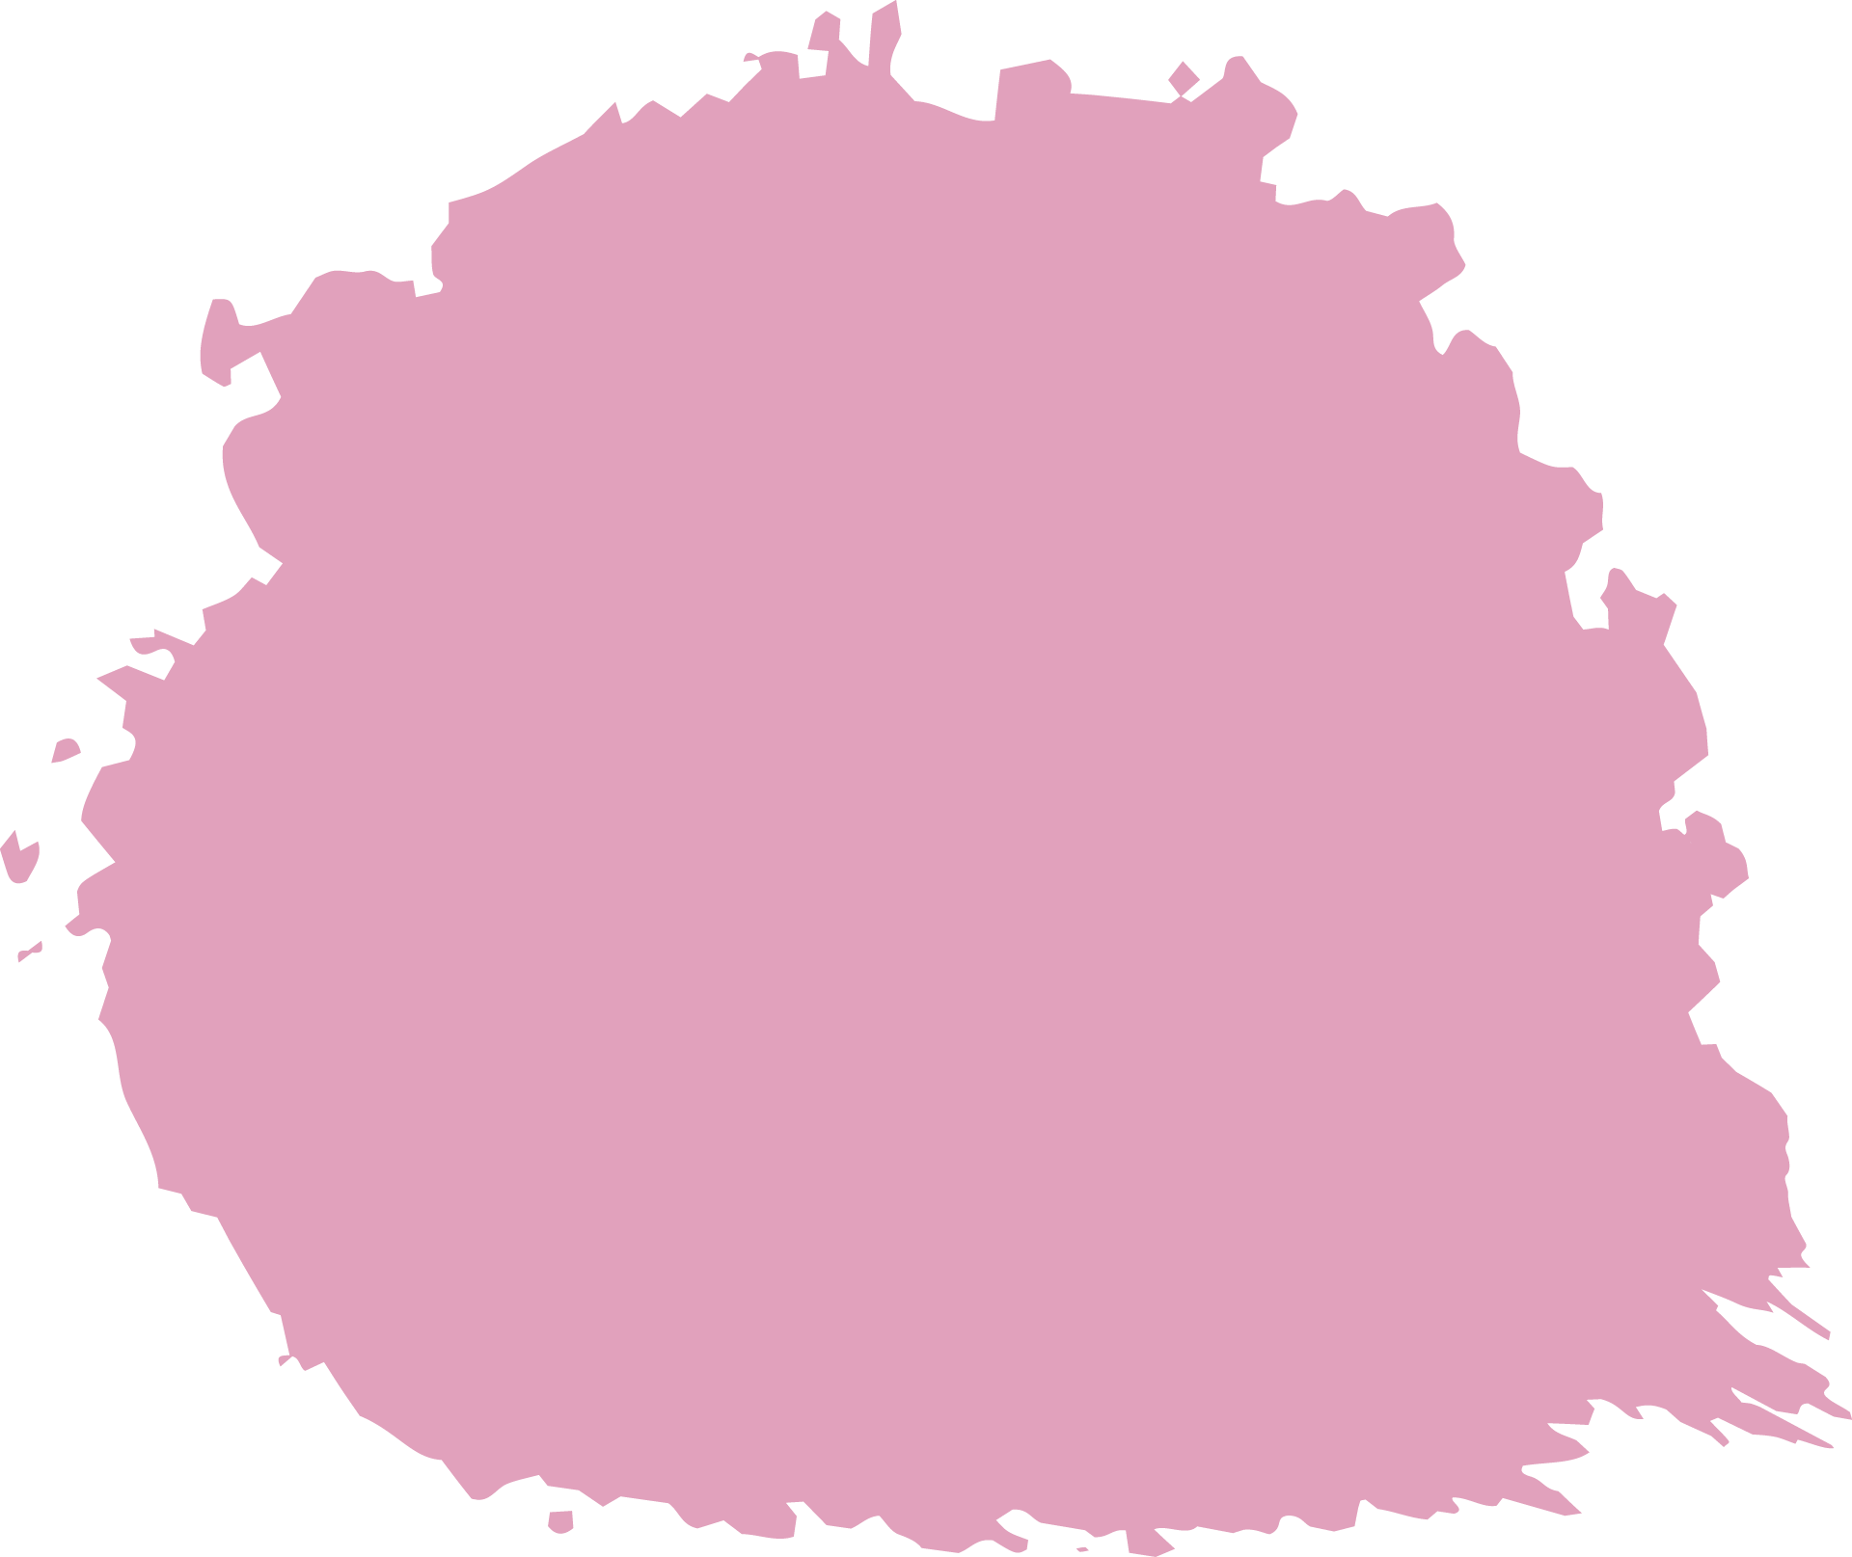
Introduction
simulates two levels of Go playing strength
predictions are made for the next move on the current Go board, with accuracy indicating whether the predicted move matches the actual move on the given board.
identify the playing style in specific game situations
Aggressive
Balanced
Territorial

Slide 6
02
Method

Slide 7
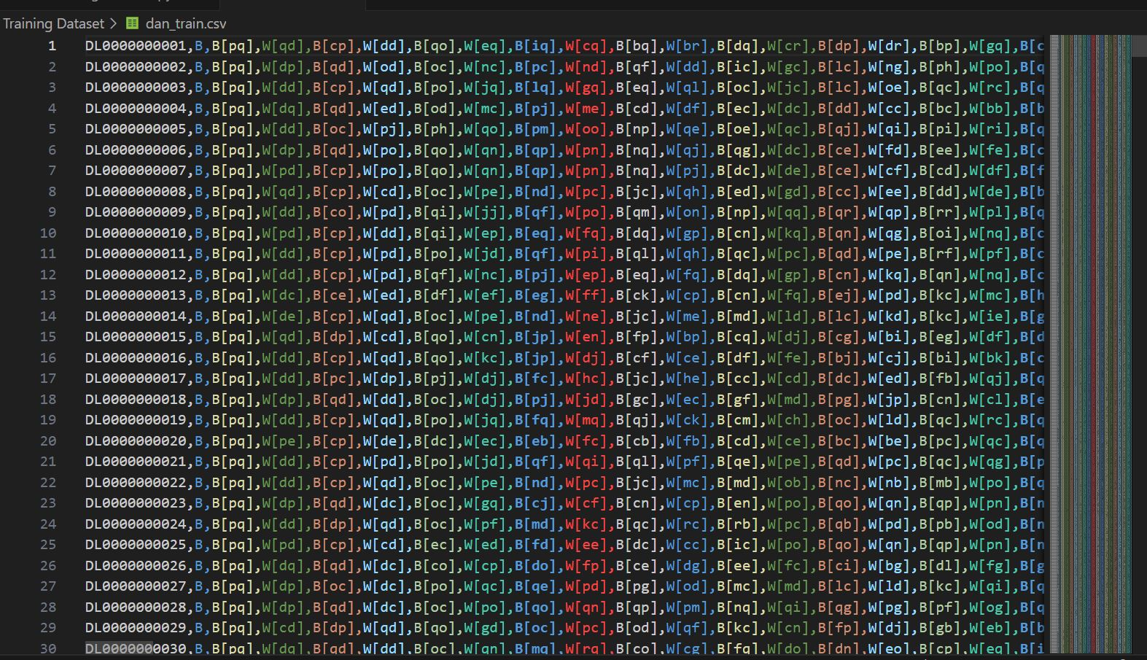
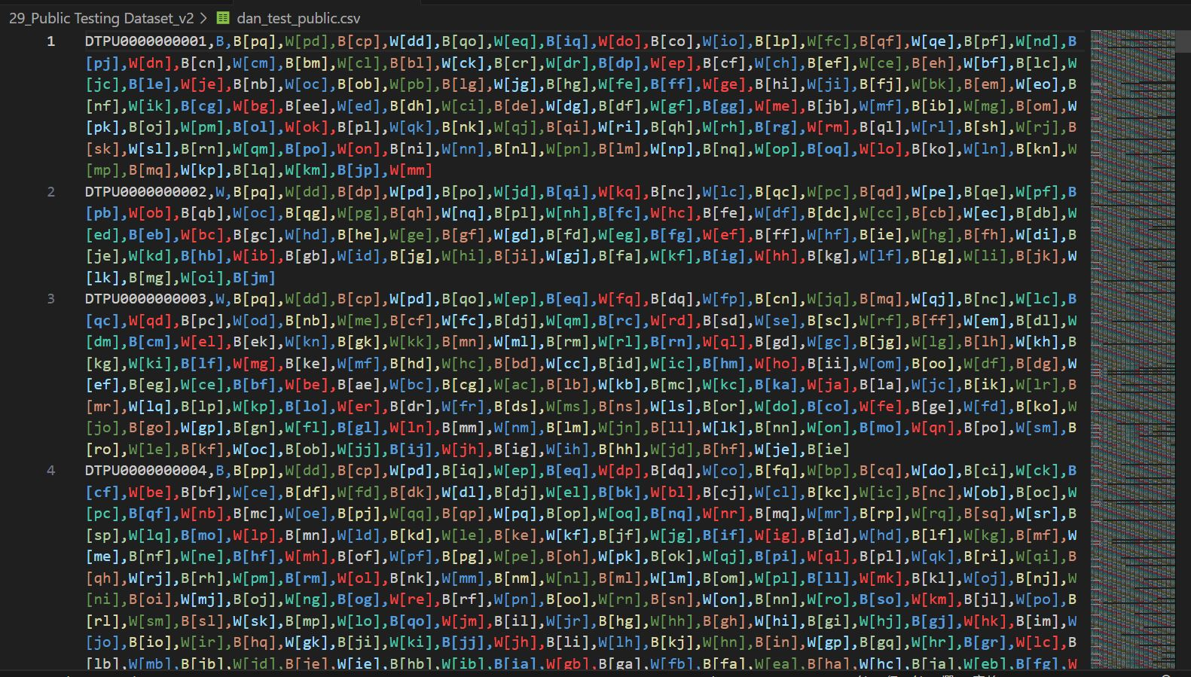
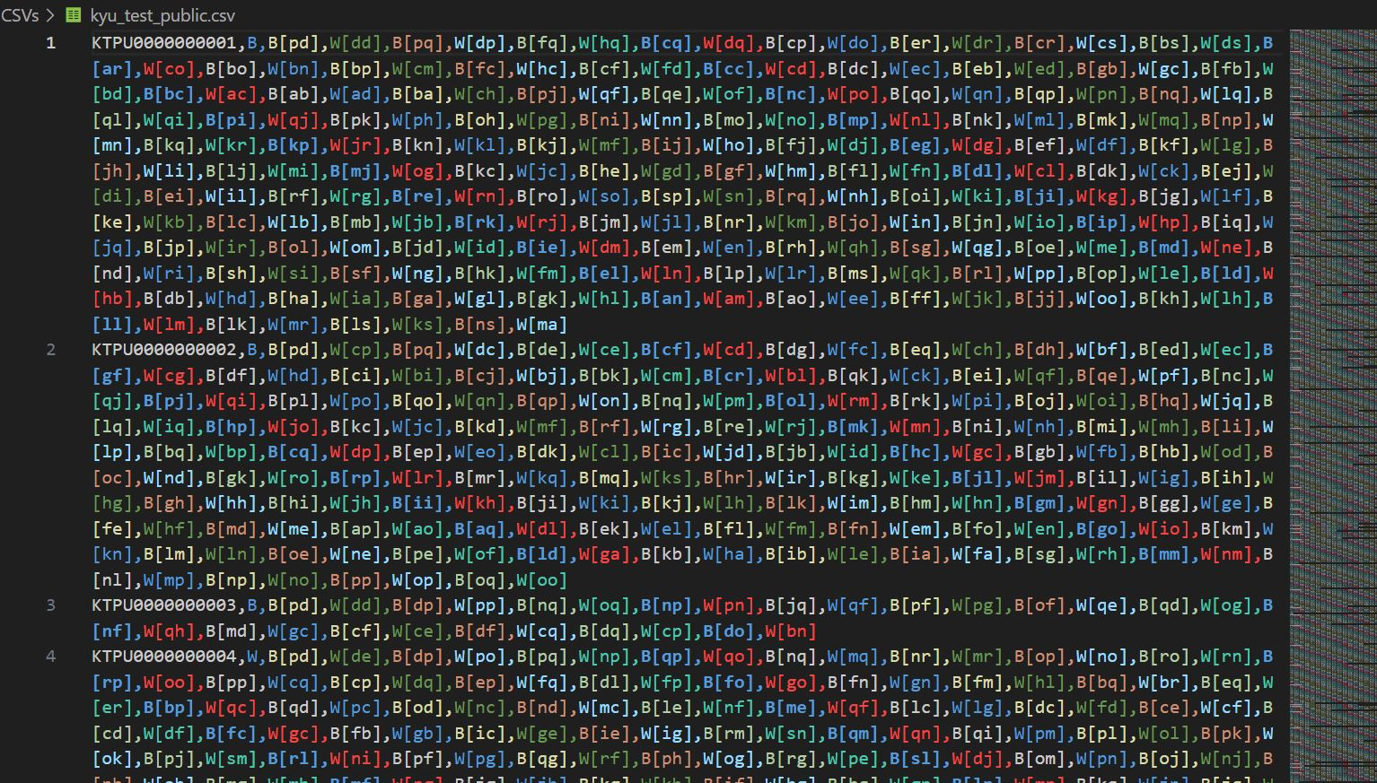
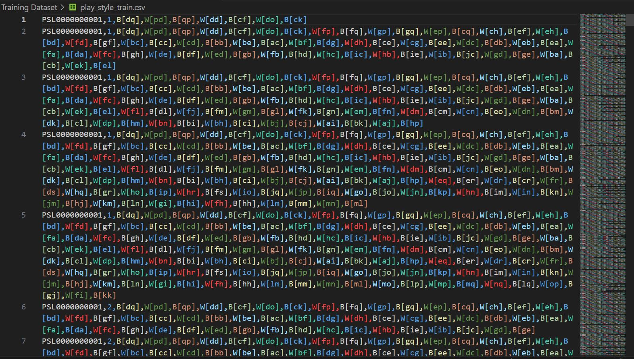
Original Dataset

Slide 8
Data Processing
Feature extraction is performed for predicting the next move of a player in the game of Go.
Six features are utilized and transformed into one-hot encoded. The first feature designates positions with black stones as 1 and others as 0.
The second feature designates positions with white stones as 1 and others as 0.
The third feature marks positions with stones as 1 and empty positions as 0.
The fourth feature indicates the position of the last move as 1 and others as 0.

Slide 9
Data Processing
Feature 1
0
1
0
0
0
1
1
0
0
0
0
0
1
0
0
0

Slide 10
Data Processing
Feature 2
1
0
1
1
0
0
0
0
0
1
0
0
0
0
0
0

Slide 11
Data Processing
Feature 3
1
1
1
1
0
1
1
0
0
1
0
0
1
0
0
0

Slide 12
Data Processing
Feature 4
0
0
0
1
0
0
0
0
0
0
0
0
0
0
0
0

Slide 13
Data Processing
The fifth feature marks positions where a black stone may be surrounded in the next move as 1 and others as 0.
The 6th feature marks positions where a white stone may be surrounded in the next move as 1 and others as 0.

Slide 14
Data Processing
Feature 5
0
0
0
0
0
0
0
0
0
0
0
0
0
1
0
0

Slide 15
Data Processing
Feature 6
0
0
0
0
0
0
0
1
0
0
0
0
0
0
0
0

Slide 16
Data Processing
For predicting player's playing style, thirteen features are employed and transformed into one-hot encoded.
The first three features are similar to the move prediction case. Additionally, the fourth feature marks positions where a black stone may be surrounded in the next move as 1 and others as 0.
The fifth feature does the same for white stones.
The 6th feature designates positions with a horizontal connection of stones as 1 and others as 0.
The 7th feature designates positions with a vertical connection of stones as 1 and others as 0.
The 8th feature designates positions with a stone in the upper-right diagonal as 1 and others as 0.

Slide 17
Data Processing
Feature 4
0
0
0
0
0
0
0
0
0
0
0
0
0
1
0
0

Slide 18
Data Processing
Feature 5
0
0
0
0
0
0
0
1
0
0
0
0
0
0
0
0

Slide 19
Data Processing
Feature 6
0
0
1
1
0
1
1
1
1
1
0
0
0
0
0
0

Slide 20
Data Processing
Feature 7
0
1
0
0
0
1
0
0
0
0
0
0
0
0
0
0

Slide 21
Data Processing
Feature 8
0
1
1
1
0
0
1
1
0
0
0
0
0
0
0
0

Slide 22
Data Processing
The 9th feature designates positions with a stone in the lower-left diagonal as 1 and others as 0.
The 10th feature identifies positions where the opponent may place a stone in the next move for an offensive strategy, assuming the player is controlling black stones.
The 11th feature serves a similar purpose but assumes the player is controlling white stones.
The 12th feature identifies positions where the player may place a stone in the next move for a defensive strategy, assuming the player is controlling black stones.
The 13th feature serves a similar purpose but assumes the player is controlling white stones.

Slide 23
Data Processing
Feature 9
0
0
0
0
0
0
0
0
1
1
0
0
1
0
0
0

Slide 24
Data Processing
Feature 10
0
0
0
0
0
0
0
1
1
0
0
0
0
0
0
0

Slide 25
Data Processing
Feature 11
0
0
0
0
0
0
0
1
1
0
0
0
0
0
0
0

Slide 26
Data Processing
Feature 12
0
0
0
0
0
0
0
1
1
0
0
0
0
0
0
0

Slide 27
Data Processing
Feature 13
0
0
0
0
0
0
0
1
1
0
0
0
0
0
0
0

Slide 28
Data Processing
We choose a Convolutional Neural Network model (DCNN Model) as it can learn intricate board features, aiding in predicting optimal moves.
The DCNN can capture both local and global board features, effectively handling the image data of the board and establishing appropriate balances in the model to enhance prediction and training accuracy for the complex game, Go.

Slide 29
Model Training
For training the model for Dan (higher-level) players, the model consists of multiple convolutional layers using the Conv2D function with filter sizes of 3x3. Each convolutional layer with BatchNormalization for improved training stability.
MaxPooling2D is applied for pooling operations, and the Flatten layer is used to convert the output into a one-dimensional tensor.
The model includes fully connected layers with ReLU activation functions and Dropout layers to reduce overfitting.
The output layer uses the Softmax activation function to output a 19x19 tensor representing the probabilities of each position for the next move.
The model is compiled using the RMSprop optimizer.

Slide 30
Model Training
For training the model for Kyu (lower-level) players, the model consists of multiple convolutional layers using the Conv2D function with filter sizes of 3x3. Each convolutional layer with BatchNormalization for improved training stability.
MaxPooling2D is applied for pooling operations, and the Flatten layer is used to convert the output into a one-dimensional tensor.
The model includes fully connected layers with ReLU activation functions and Dropout layers to reduce overfitting.
The output layer uses the Softmax activation function to output a 19x19 tensor representing the probabilities of each position for the next move.
The model is compiled using the RMSprop optimizer.

Slide 31
Model Training
For training the model to recognize playing styles, the model includes convolutional layers with Dropout regularization, and Dense layers with L2 regularization.
The output layer uses Softmax activation for a 3-dimensional vector representing the three playing styles (aggressive, balanced, territorial).
The model is compiled using the RMSprop optimizer.

Slide 32
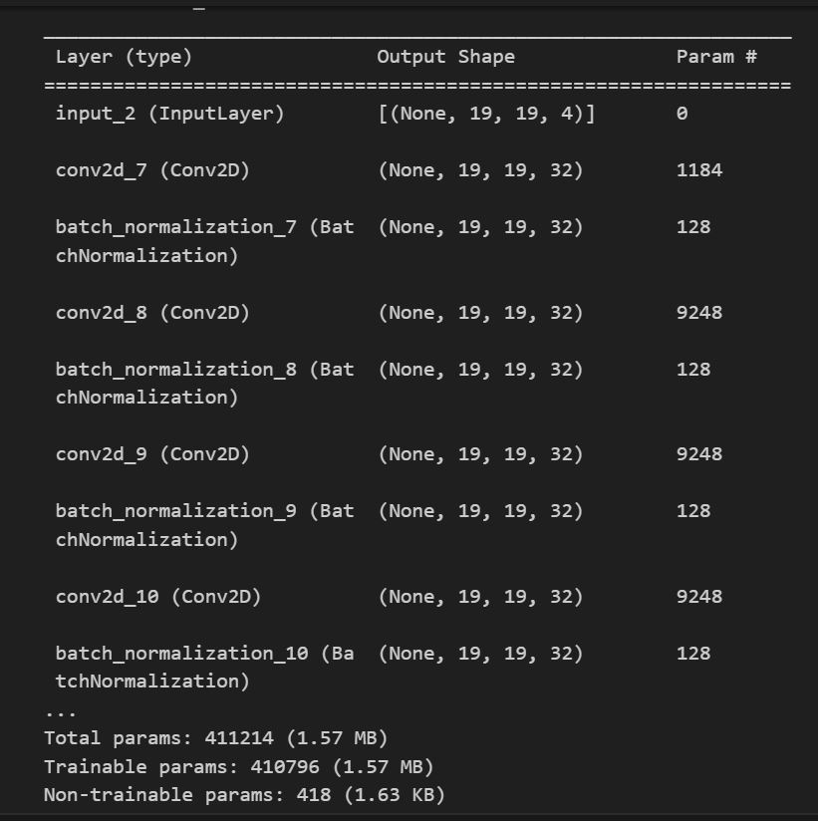
Training Models-Old version
Dan model

Slide 33
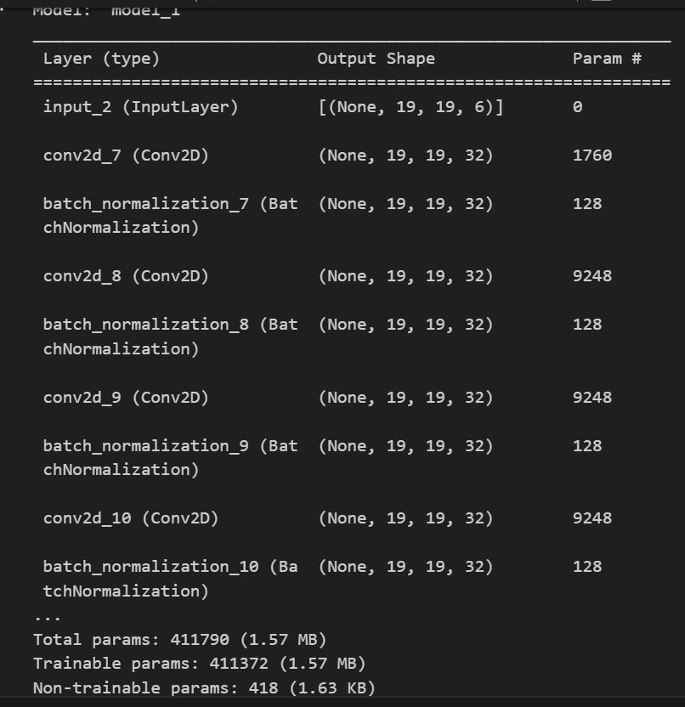
Training Models-New version
Dan model

Slide 34
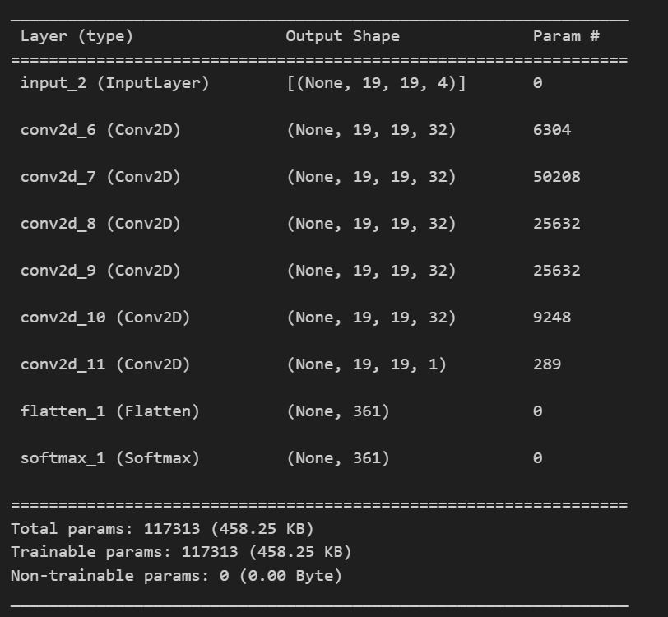
Training Models-Old version
Kyu model

Slide 35
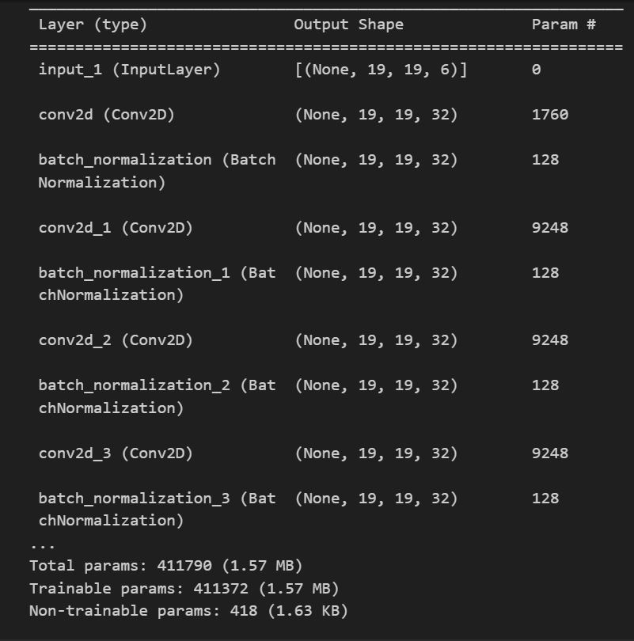
Training Models-New version
Kyu model

Slide 36
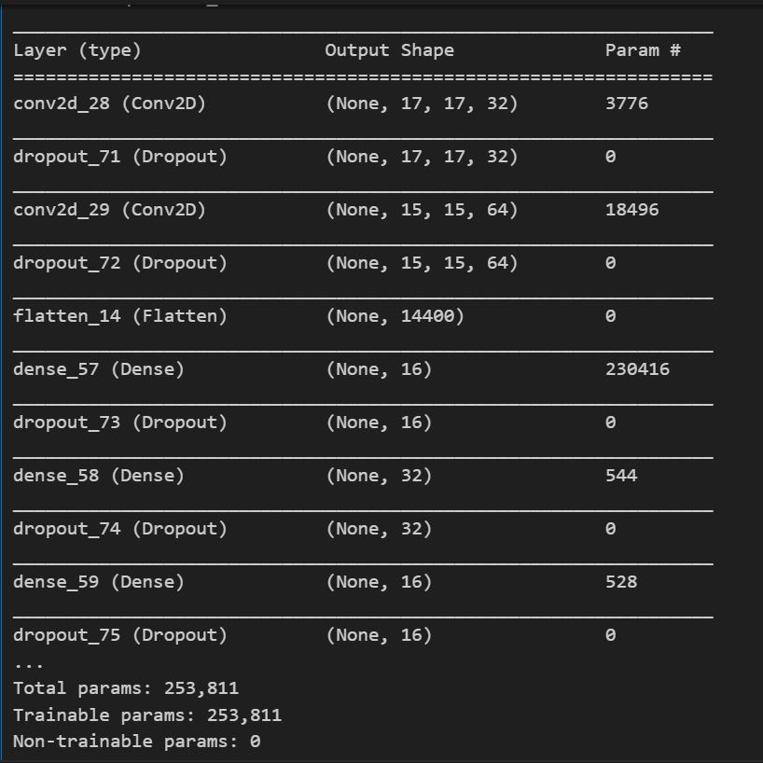
Training Models
Playing-style model

Slide 37
03
Experiment & Conclusion

Slide 38
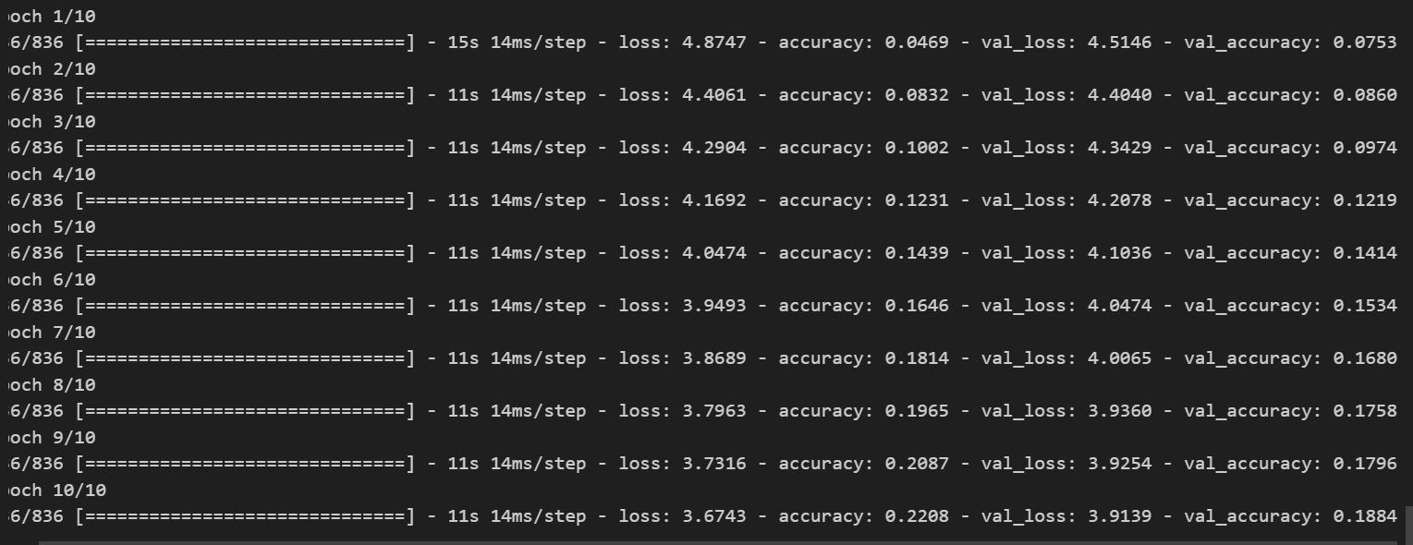
Dan Model-Old version
m

Slide 39
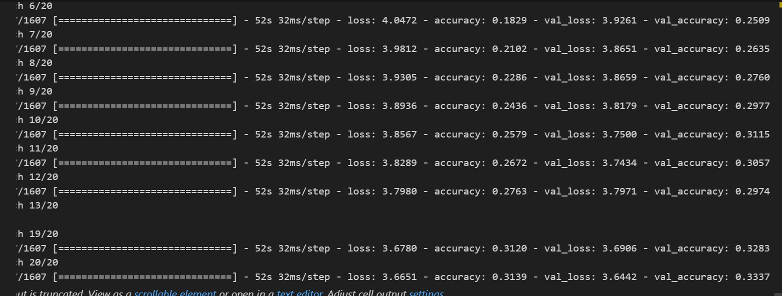
Dan Model-New version
m

Slide 40
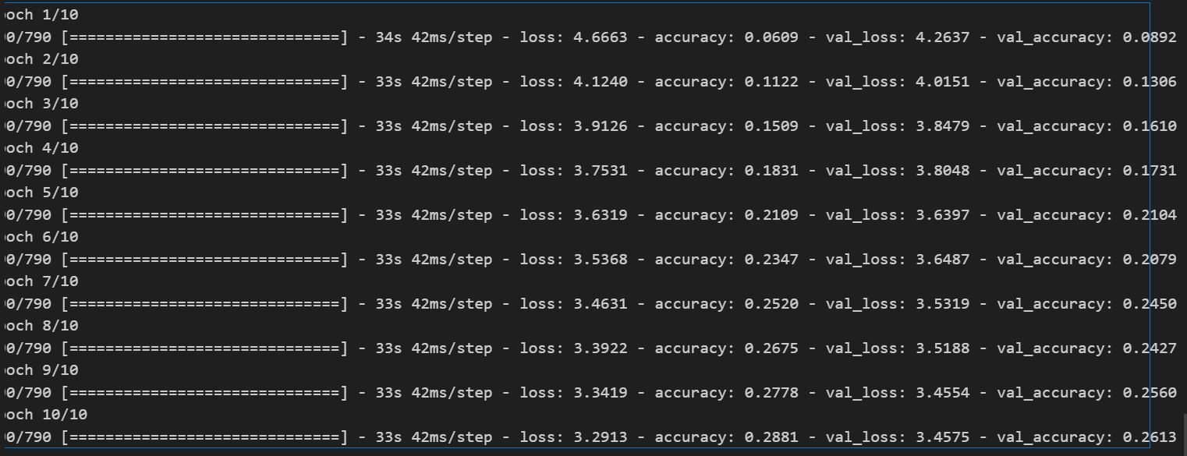
Kyu Model-Old version
m

Slide 41
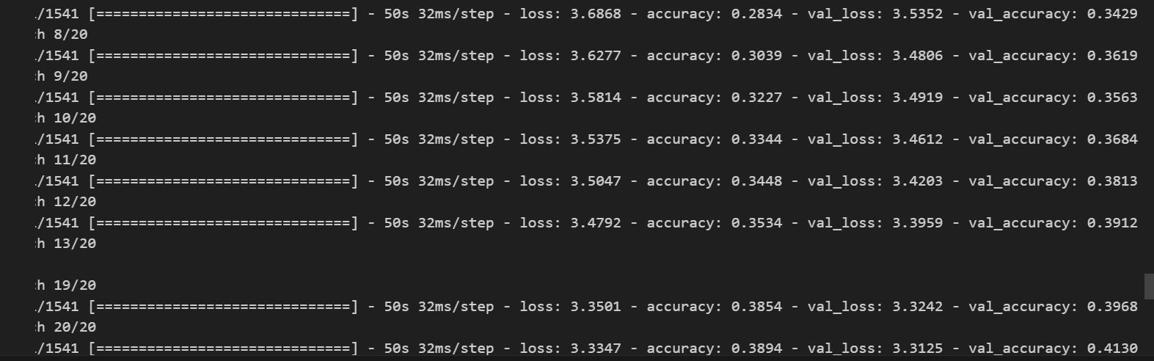
Kyu Model-New version
m

Slide 42
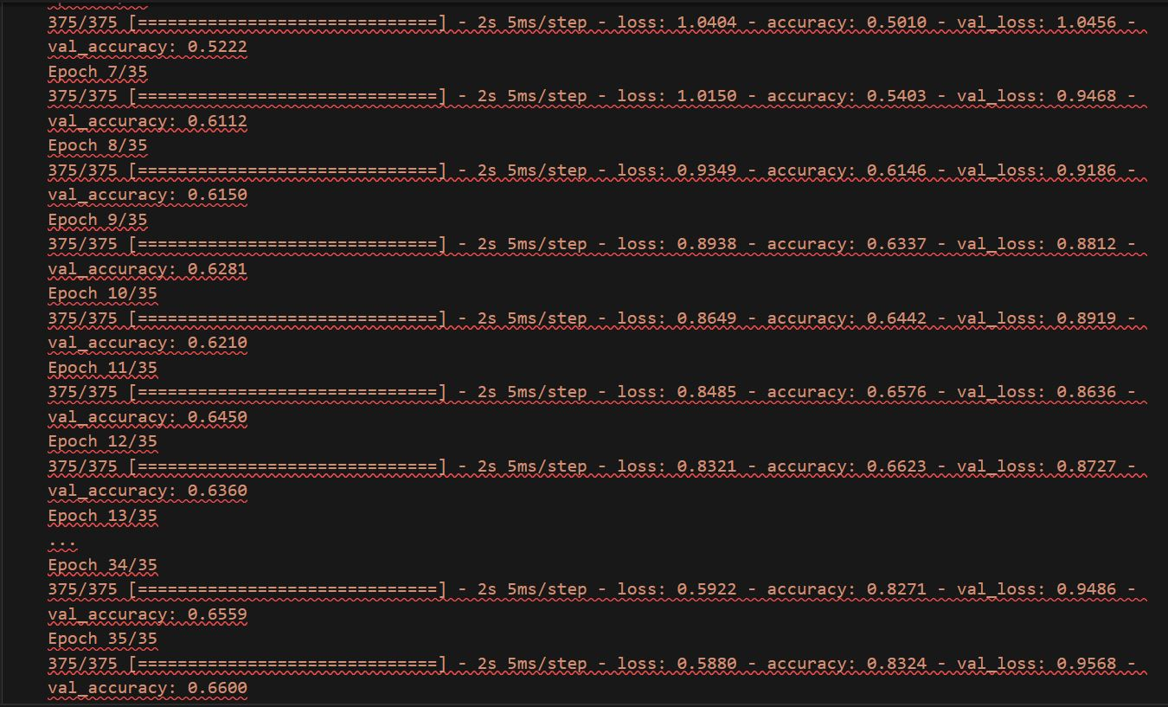
Playing-style Model
m

Slide 43
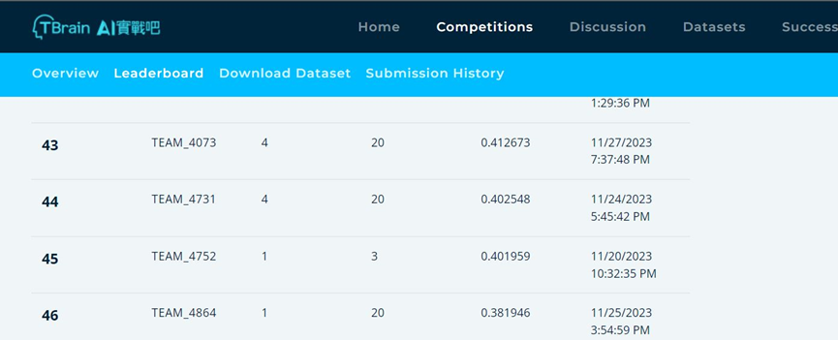
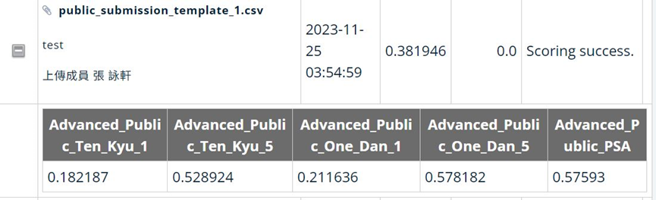
Public_test & Leaderboard [46/508]

Slide 44
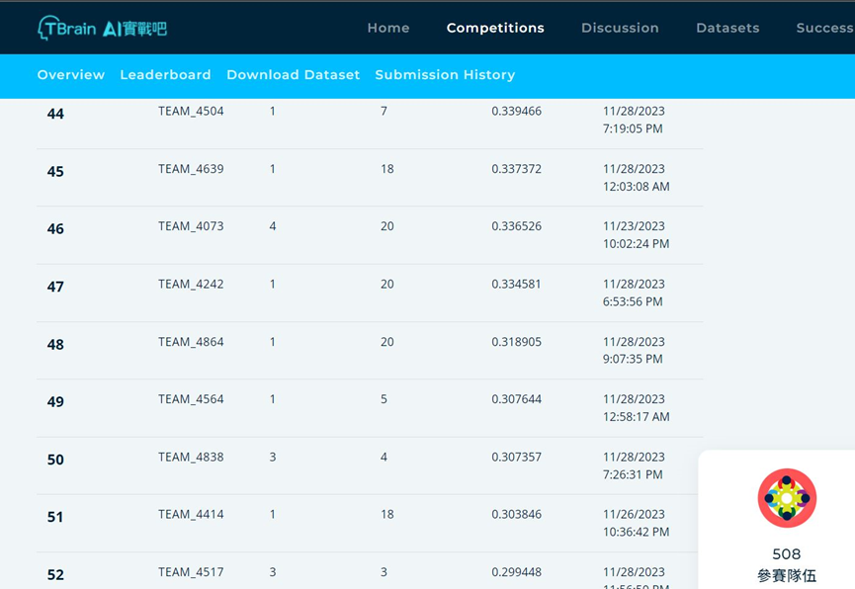
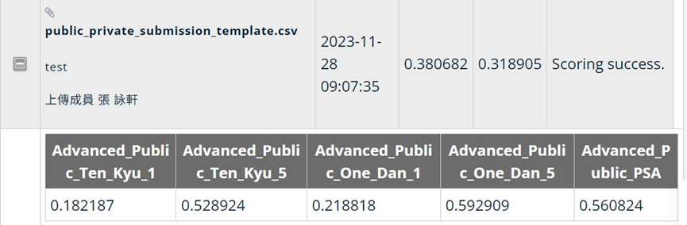
Private_test & Leaderboard [48/508]

Slide 45
Conclusion
Go itself is a complex game, making this project highly challenging. Conducting a comprehensive evaluation across various skill levels and styles involved analyzing others' playing styles, imitating them, predicting the next moves, and identifying different playing styles. This deepened our application and understanding of deep learning.
While the model trained on the training set exhibited high accuracy, there remains ample room for improvement upon testing with the official dataset.

Slide 46
Conclusion
Enhancements could include more precise and multifaceted feature extraction, experimenting with different activation functions, employing additional regularization or adjusting convolutional layers, along with variations in training volume and fine-tuning the learning process to prevent overfitting.

Slide 47
Reference
"Mastering the game of Go with deep neural networks and tree search"
David Silver, Aja Huang, Chris J. Maddison, et al.
Nature, vol. 529, no. 7587, pp. 484-489, 2016.
"Mastering Chess and Shogi by Self-Play with a General Reinforcement Learning Algorithm"
David Silver, Thomas Hubert, Julian Schrittwieser, et al.
Science, vol. 362, no. 6419, pp. 1140-1144, 2018.
"Training deep convolutional neural networks to play Go"
Christopher Clark, Amos Storkey
arXiv preprint arXiv:1412.3409, 2014.
"ImageNet Classification with Deep Convolutional Neural Networks"
Alex Krizhevsky, Ilya Sutskever, Geoffrey E. Hinton
Advances in Neural Information Processing Systems (NIPS), 2012.

Slide 48
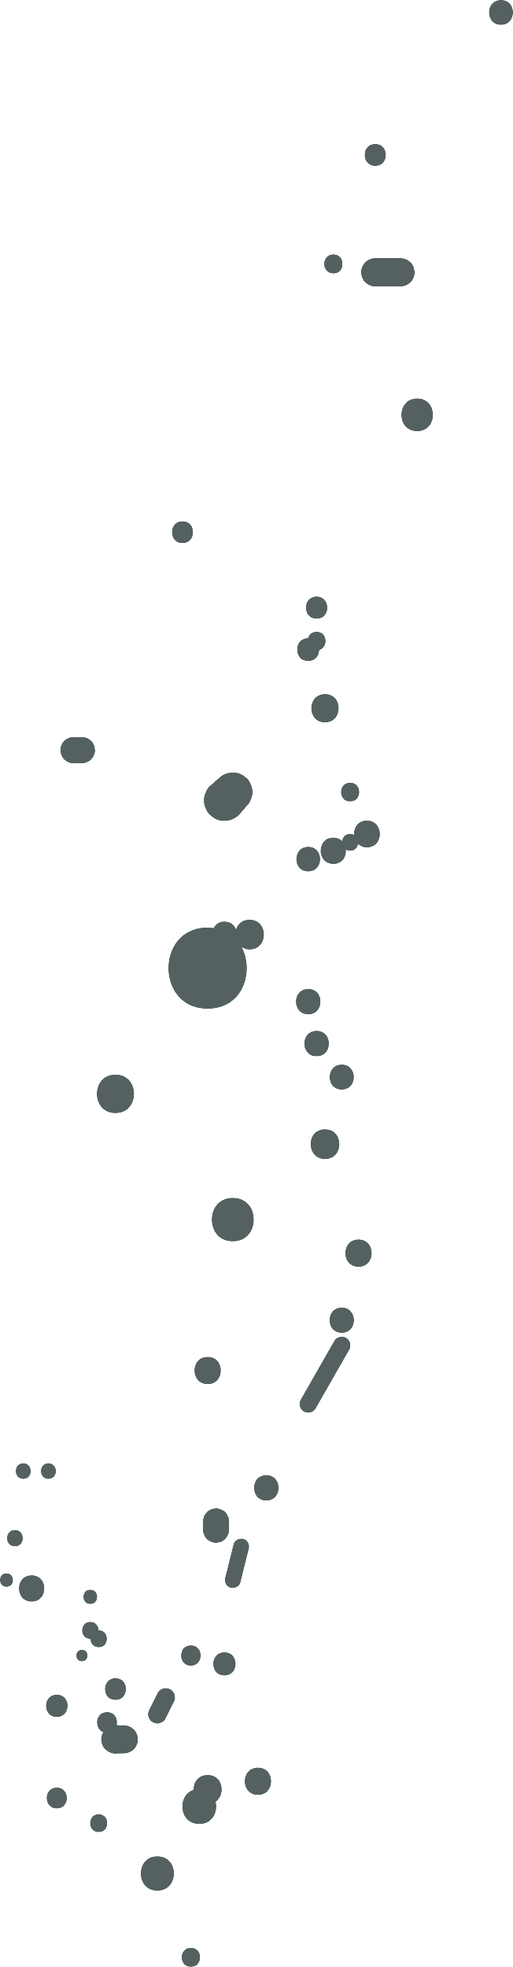
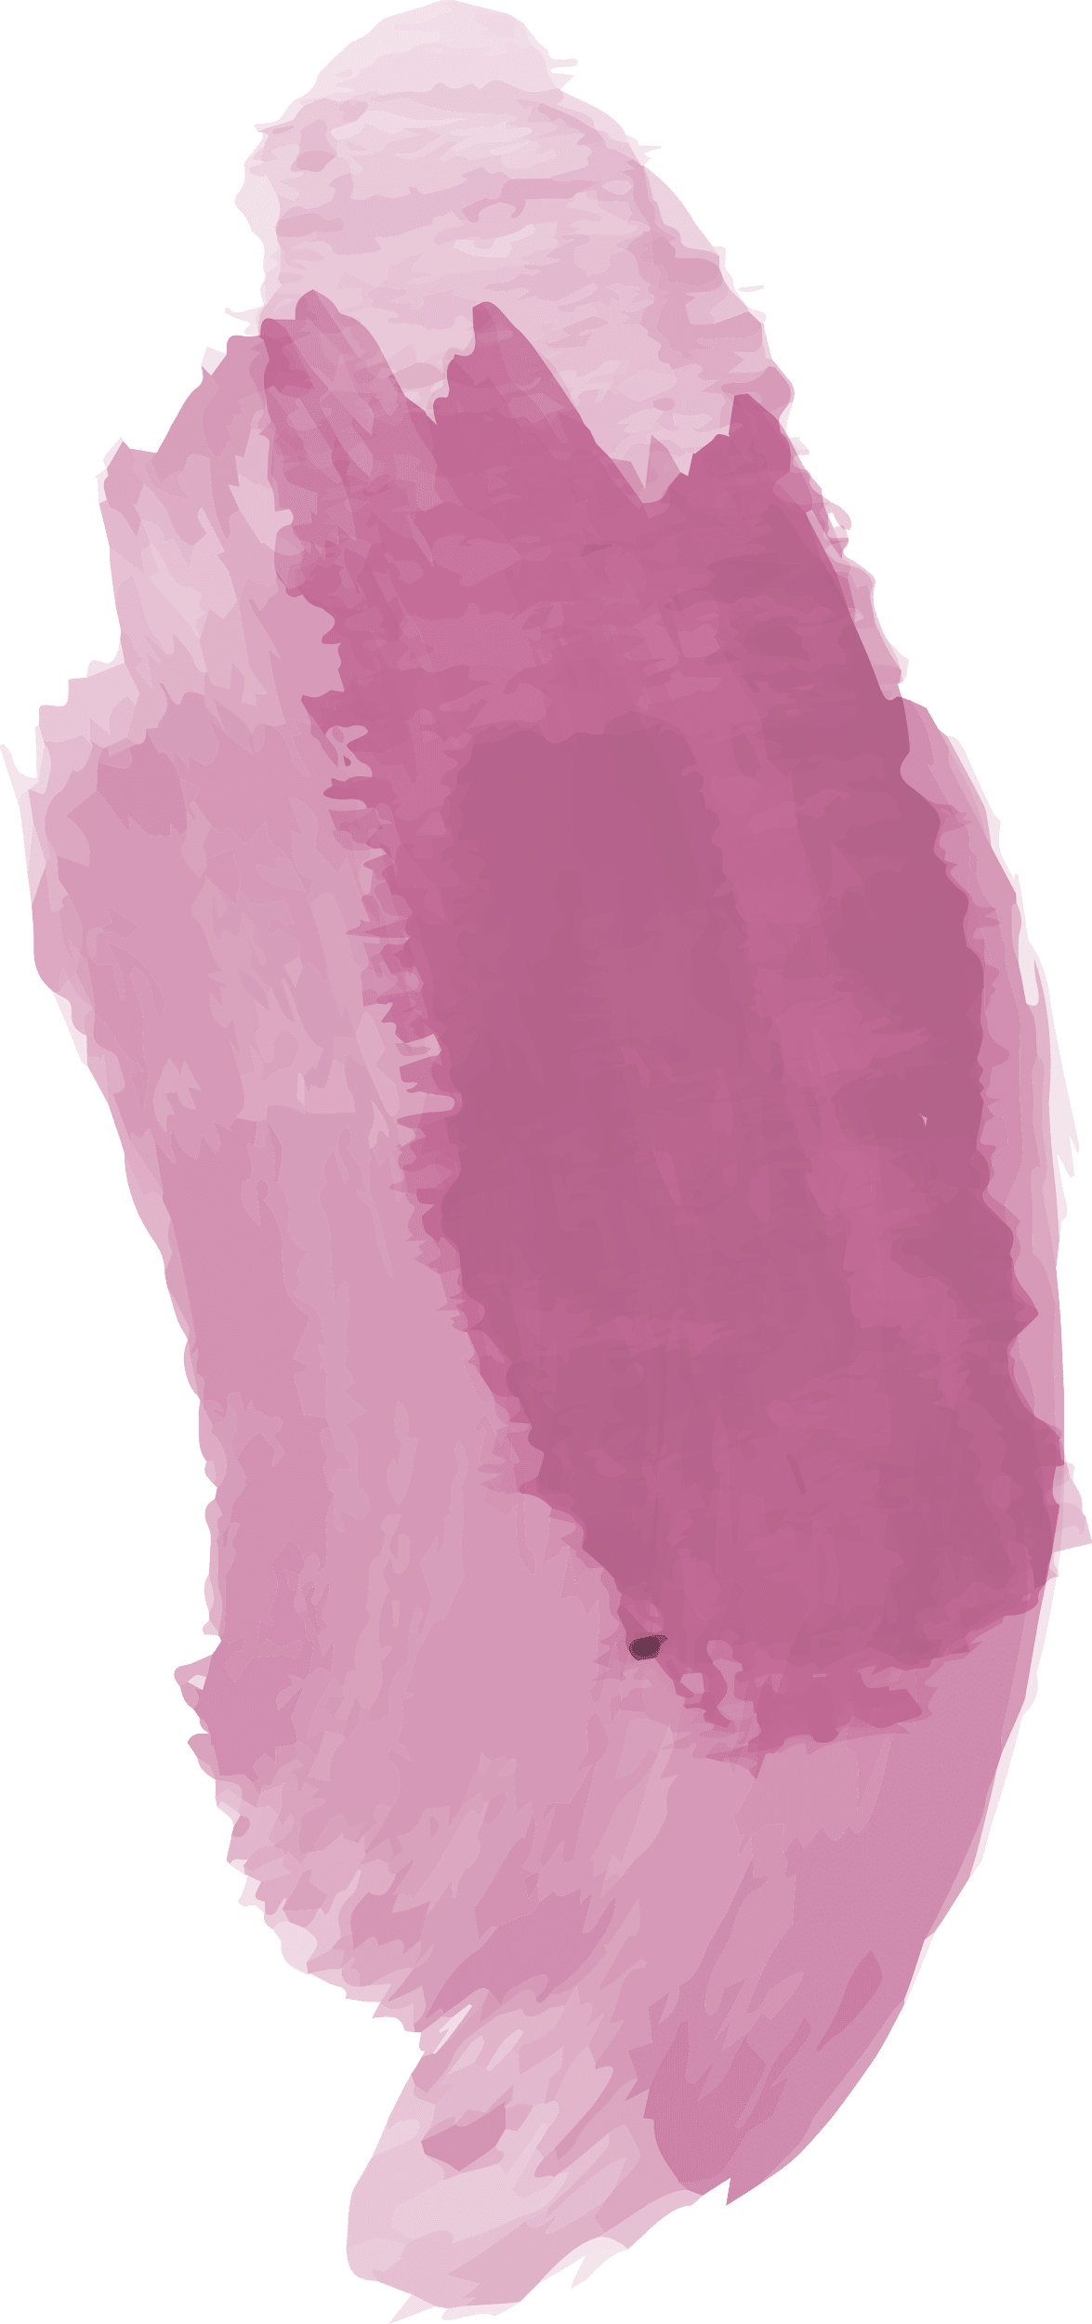
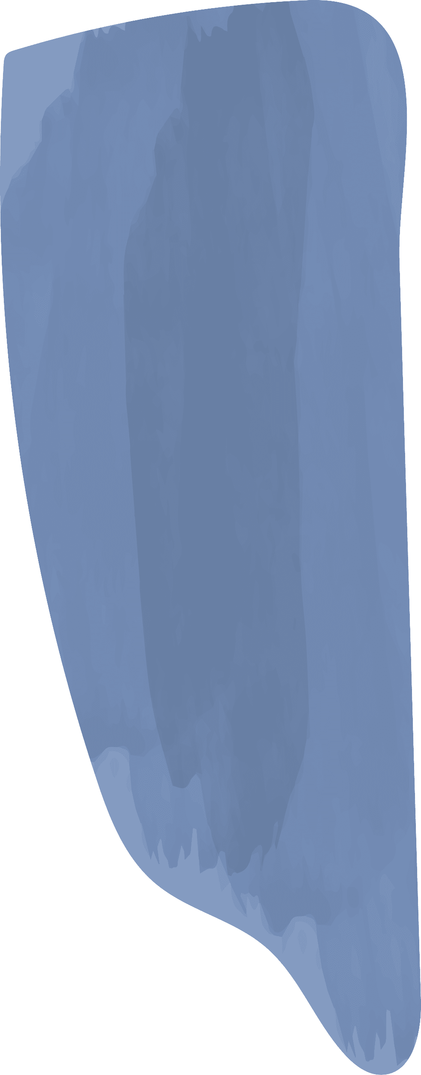
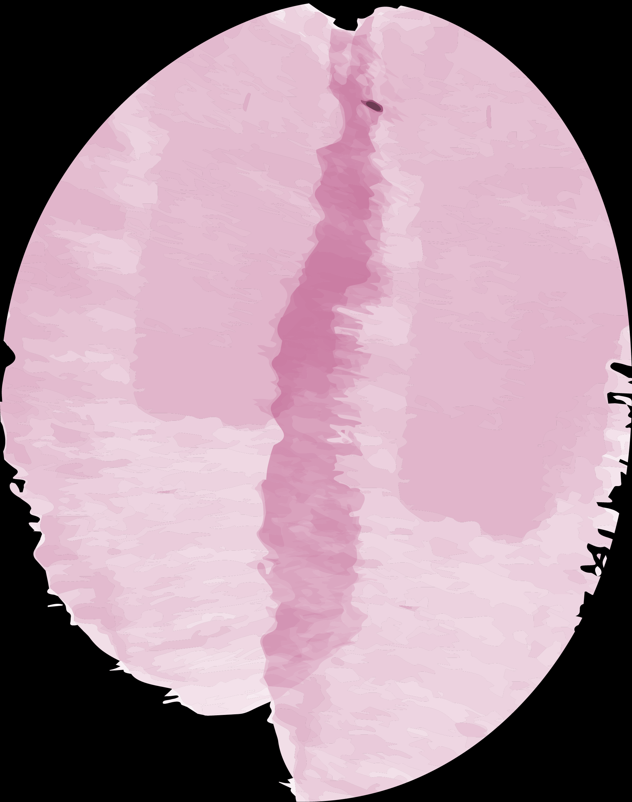

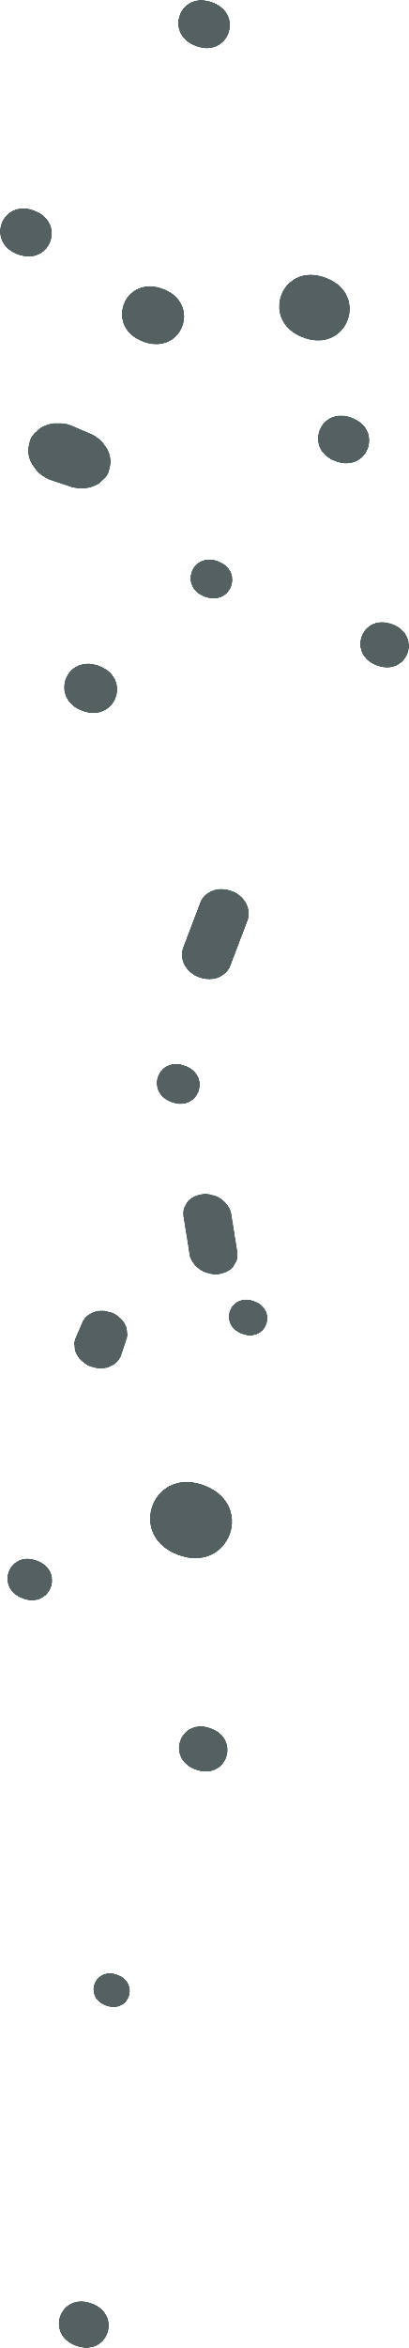

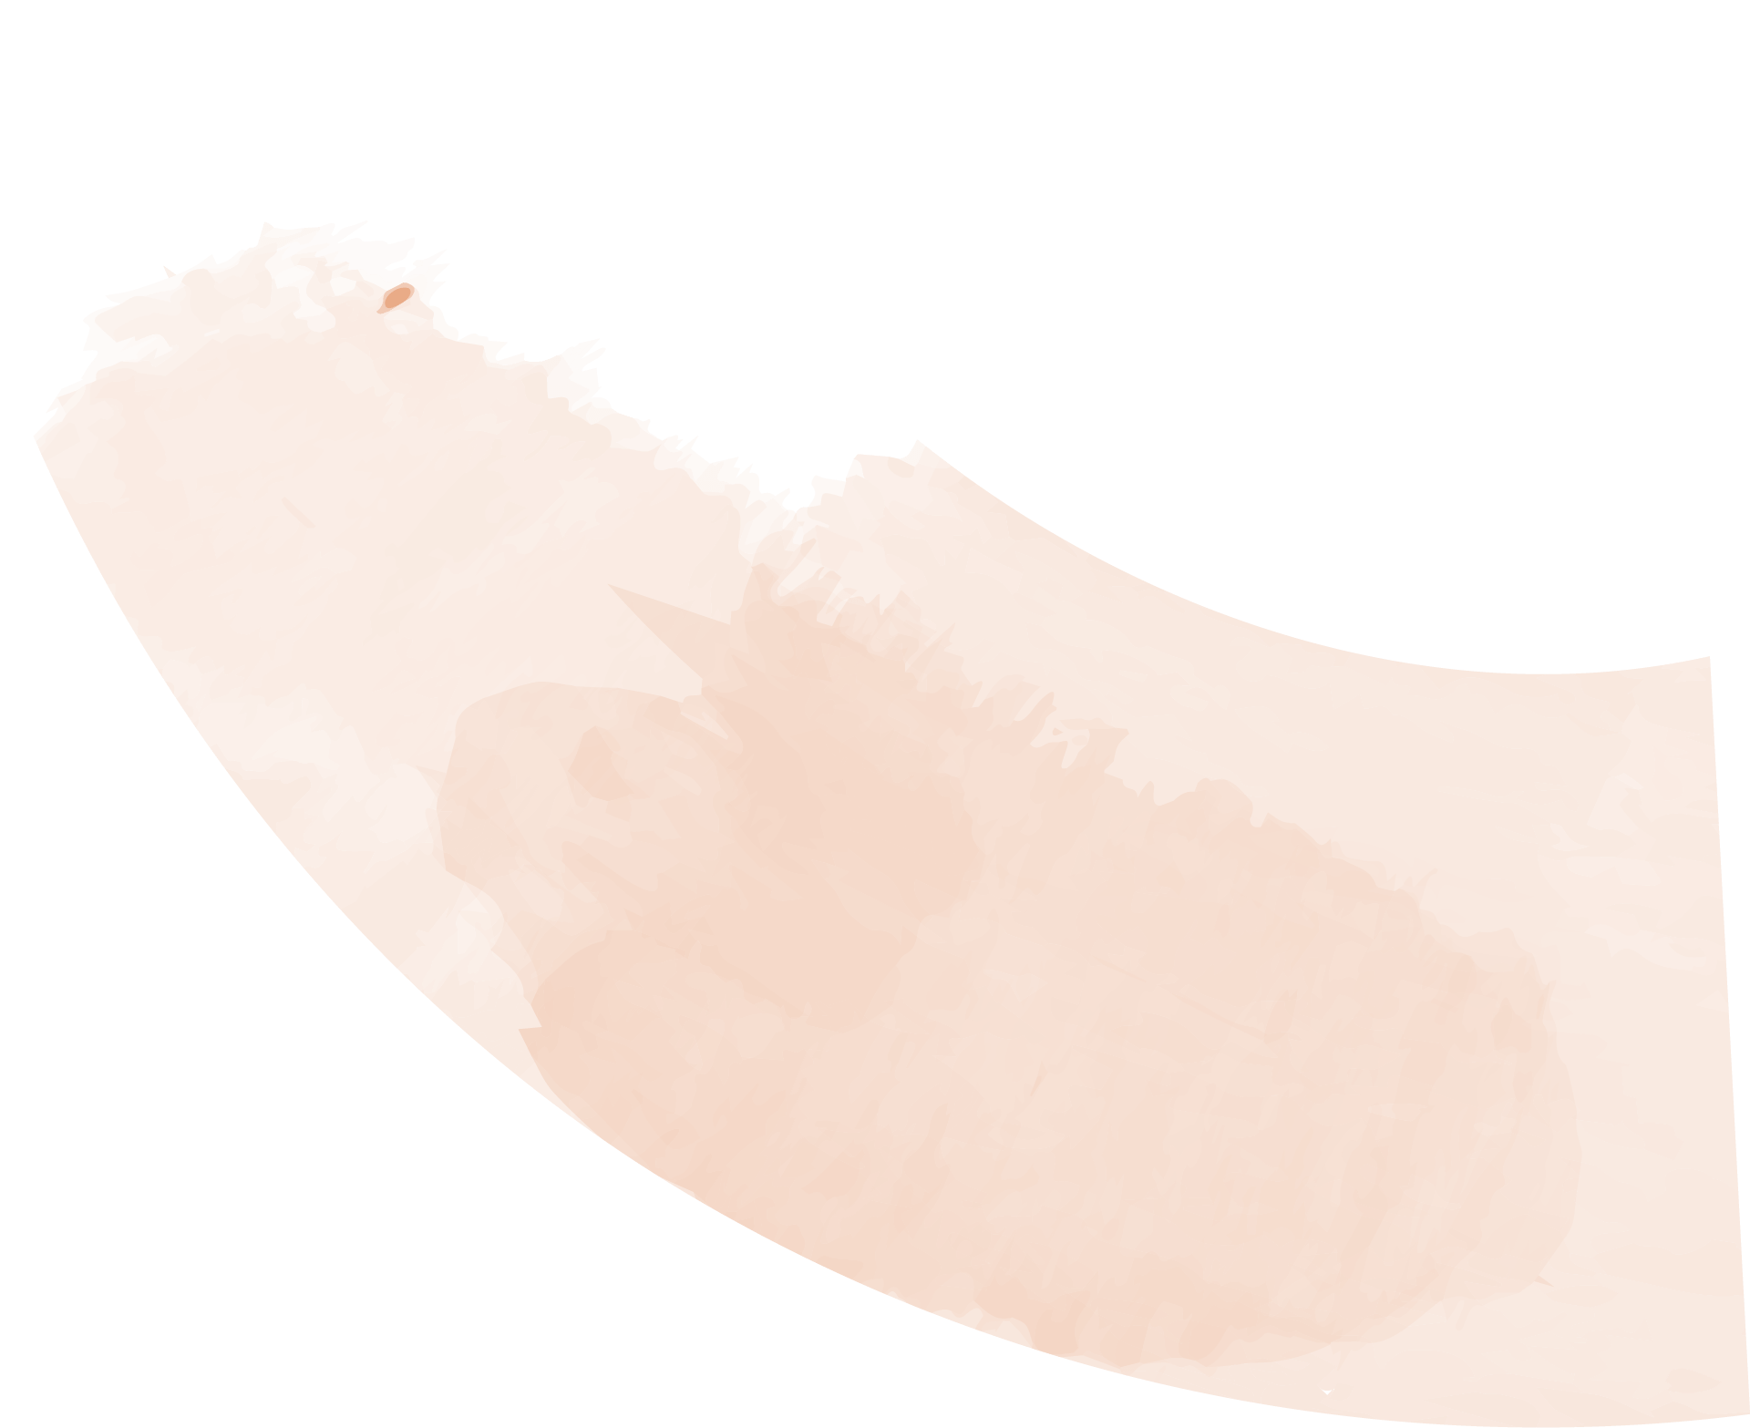
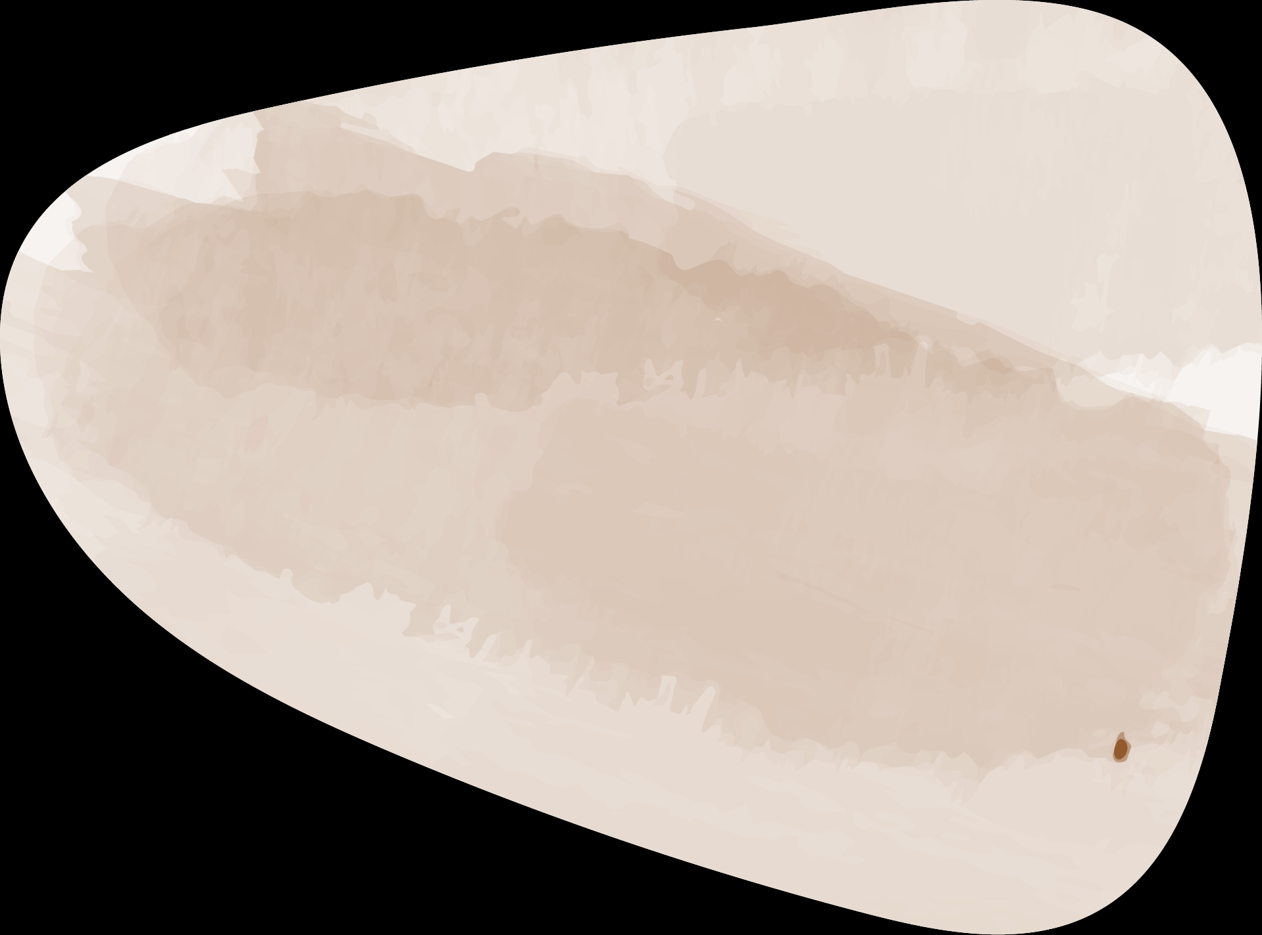
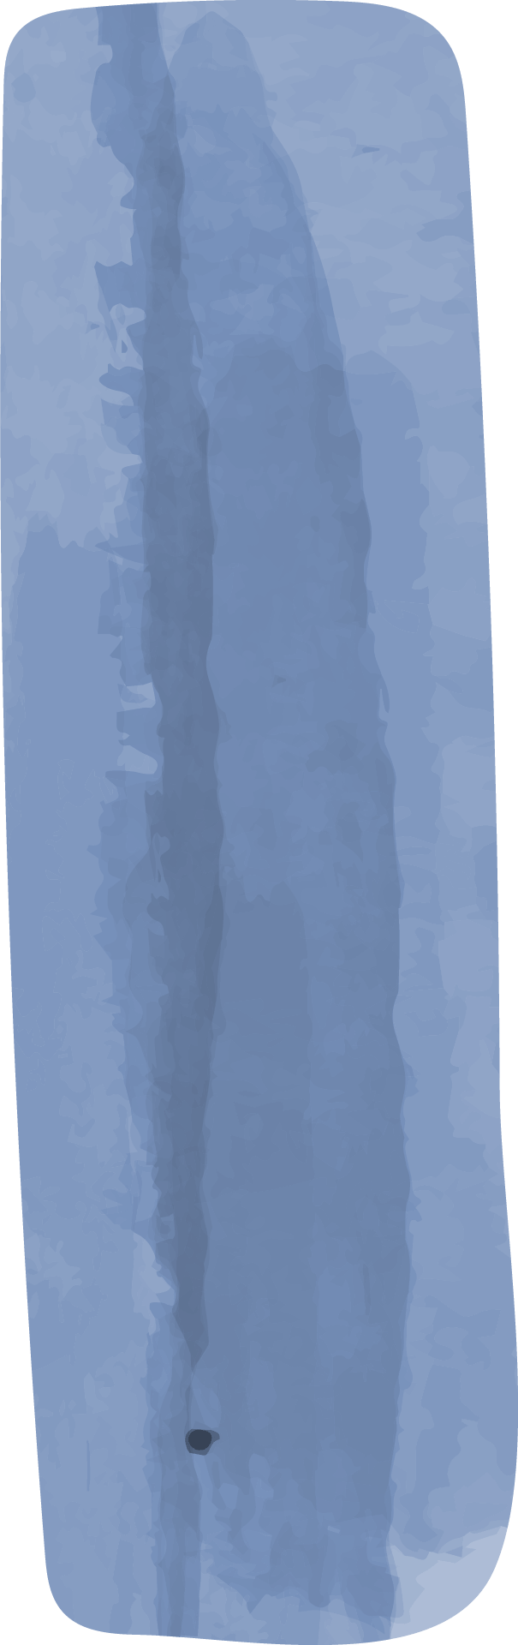
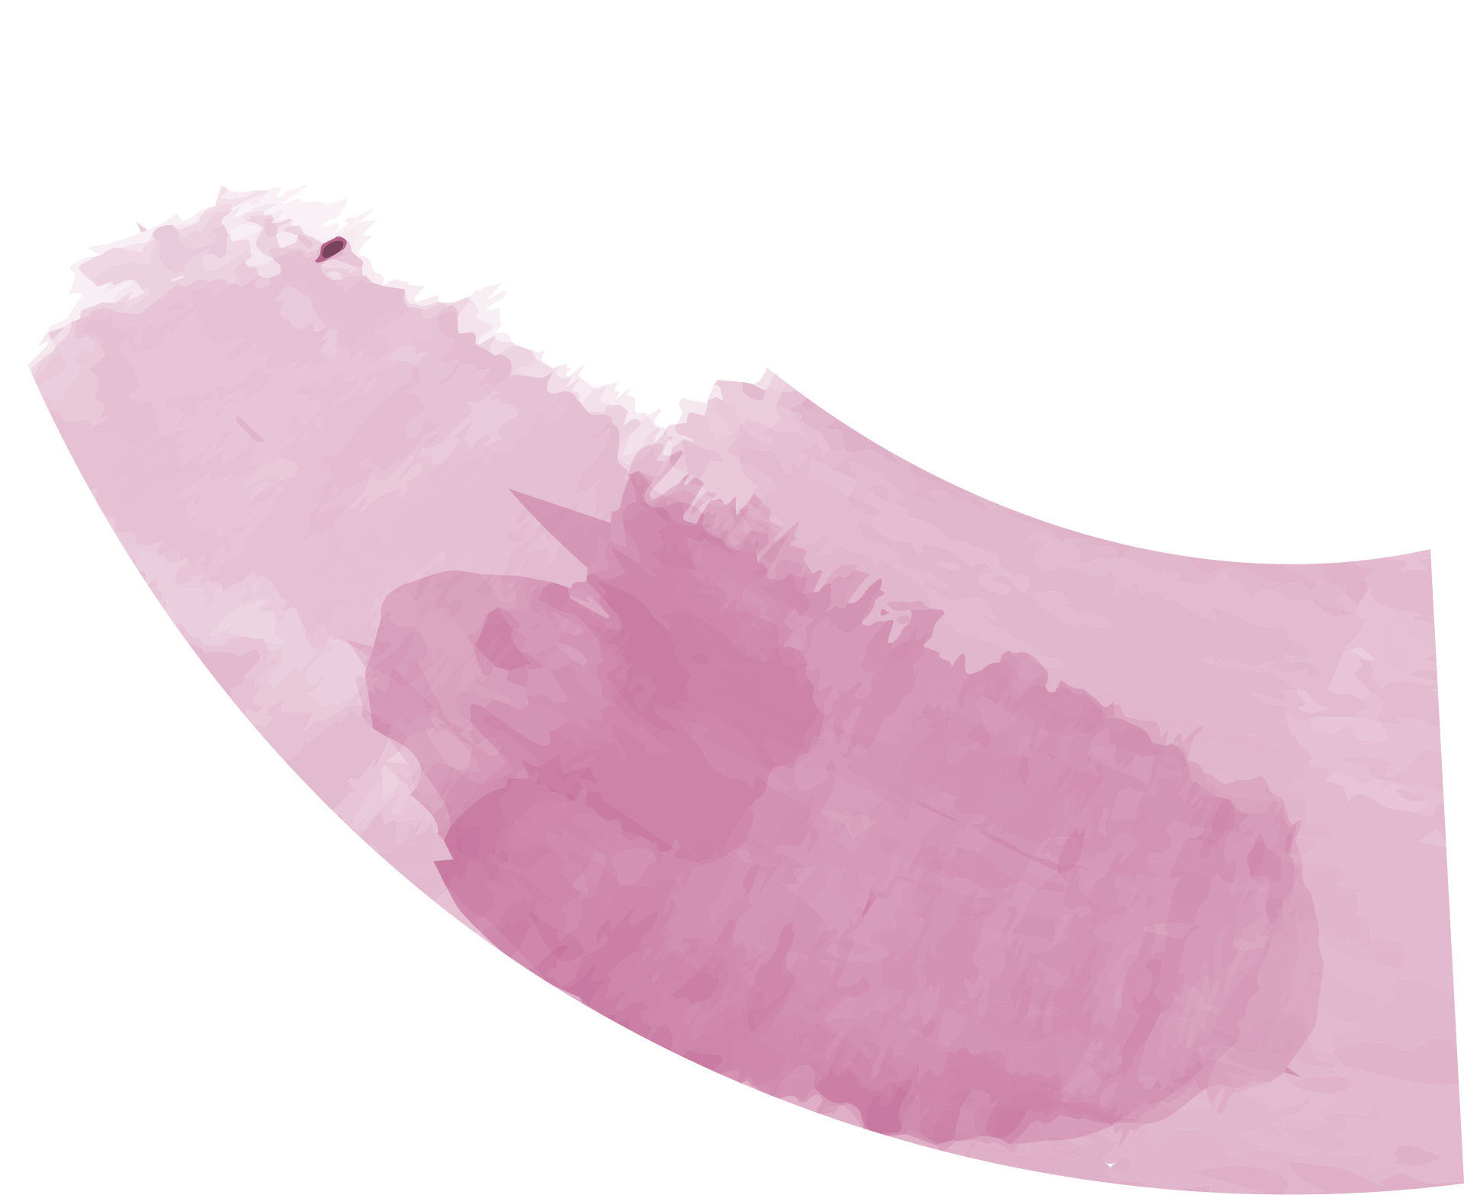

Thanks for listening

